Slide 1
CS 4310: Software Engineering
Lecture 17
Software Metrics

Slide 2
Software Measurement and Metrics
Software measurement is concerned with deriving a numeric value for an attribute of a software product or process
This allows for objective comparisons between techniques and processes
Although some companies have introduced measurement programs, the systematic use of measurement is still uncommon
There are few standards in this area

Slide 3
What is a Software Metric?
Quantitative measure of the quality of software.
Measure of the difficulty of testing, understanding, or maintaining a piece of software
Measure of ease of using software
Software complexity is measure of human performance
Computational complexity is a measure of program performance (Algorithm complexity)

Slide 4
Software Metric
Any type of measurement which relates to a software system, process or related documentation
  Lines of code in a program, the Fog index, number of person-days required to develop a component
Allow the software and the software process to
be quantified
Measures of the software process or product
May be used to predict product attributes or to control the software process

Slide 5
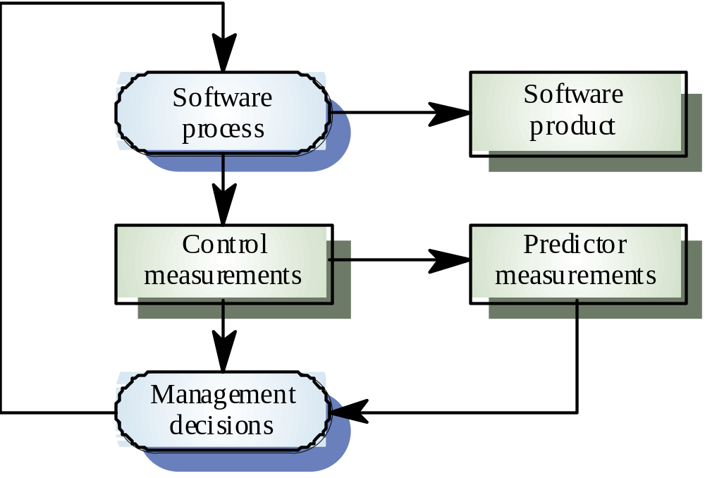
Predictor and Control Metrics

Slide 6
Commonly Accepted Heuristics
70 - 80% of resources spent on maintenance
Average programmer -> 10-15 LOC/day
10-15% of project is coding
Module should contain <= 50 LOC
Module’s “span of control” = 7 +/- 2
S/W development backlogs 3-7 years

Slide 7
Uses of Software Metrics
Identify parts of program most likely to be hard to work with (e.g. test, maintain, understand, ...)
Aid in allocation of testing and maintenance resources
Predictors of size of effort or number of bugs
Feedback to programmers

Slide 8
Classification of Software Metrics
Size Metrics
Logical Structure Metrics
Data Structure Metrics
Interconnection Metrics
Object-Oriented Metrics
Function Points

Slide 9
Size Metrics
The larger the more complex – There are many ways to define size of a program
1. Lines of Code (LOC)
Standard definition of LOC
  Count number of lines and data definitions
  Do not count comment lines
  Count a line containing both a statement or part of a statement and a comment as an executable line.

Slide 10
Problems with LOC
Lack of a Standard definition for line of code.
Counting types of lines.
  Executable lines
  Data definition
  Comments
  Blank line
Application written in multiple language.
Size variation due to individual programming style.

Slide 11
Size Metrics
2. Number of Tokens -- A detailed measure of size
Size of program is number of tokens, where a token is a
  lexical token
  keyword, arithmetic operator, constants, grouping symbol such as parenthesis or bracket and so forth)
Problems:
  What is a token?
  Token count can be padded

Slide 12
Size Metrics
3. Function Count -- Coarse measure of program size.
  Function count is the number of functions in the program.
  Attempts to define size in terms of the number of tasks the program performs.
Problems with function count
  What is a function?
  Function count depends on how problem broken up
  Function count can be padded or made very small

Slide 13
Logical Structure Metrics
Intuition
  The more complex the logical structure of the program the more complex the program.
  The more complex the flow of control in the program the more difficult it will be to test, understand, or maintain the program.
A program with high logical complexity has
  Many conditional and looping statements with deep nesting.
  Highly unstructured (spaghetti code)

Slide 14
McCabe's Cyclomatic Complexity V(G)
Uses a Program Control Graph
Basis for McCabe's metric
  Measure of complexity is number of different paths through the program control graph
  Number of basic paths (all paths composed of basic paths)
Cyclomatic Number is the number of basic paths.
V(G) = Cyclomatic Complexity
= edges - nodes + connected parts
= Number of predicates in program + 1

Slide 15
Cyclomatic Complexity
Simple to compute V(G)
    V(G) is a very popular measure.
    Count a compound predicate as one or as one plus the number of Logical operators?
    V(G) is a lower bound for number of test cases for branch coverage.
    Quantitative basis for modularization.

Slide 16
Data Structure Metrics
Data structures measure the amount of data input to, processed in, or outputted from a program
    1. Amount of data
    2. Data usage within a module
    3. Data sharing among modules
    4. Relate to cost of implementing data structure

Slide 17
Interconnection Metrics
Measures the amount of information communicated or shared between modules
Information shared
Modules calls, parameters passed, global variables, data returned from module
Problems
  1. Quantifying the information flow between modules
  2. Relative contribution of system level complexities to total complexity of the program
  3. Information passed both directly and indirectly

Slide 18
Object-Oriented Complexity Metrics
Claims of Object Orientation
  Higher quality of software
  More reuse
  More easily extended
Traditional metrics do not capture unique aspects of Object Oriented Programs

Slide 19
Object Oriented Metrics
Number of children (NOC)
  Number of children (immediate subclasses)
Count of methods in a class (WMC)
  Number of methods in a class
Depth of Inheritance Tree (DIT)
  Length of maximal path to root of class hierarchy
Coupling measure (CBO)
  Number of classes to which a class is coupled (calling another method or instance variable)

Slide 20
Object Oriented Metrics
Response to a message (RFC)
  Cardinality of the set of all methods that can execute in response to a message to an object of a class
Cohesiveness (LCOM)
  Count of number of method pairs that do not have common instance variables minus the count of method pairs that do

Slide 21
Function Points
Measures amount of functionality in a system described by specs
  Relates directly to requirements
  Available early in development
  Use as a productivity measure

Slide 22
Function Points
Weighted sum of following:
1. External inputs - provided by user that describe distinct application-oriented data (e.g. file names)
2. External outputs - items provided to user that generate distinct application-oriented data (e.g. reports)
3. External inquiries - interactive inputs requiring a response
4. External files - machine readable interfaces to other systems
5. Internal files - logical master files in the system

Slide 23
Function Points
Function Point Example
Application Function Points I O I T I
Money Transfer System 105 18 55 0 7 20
Job Costing 485 26 18 2 52 2
Meat Processing 654 28 30 7 35 0
Utility Rates 1777 37 28 6 30 0
Corporate Accounting 2047 34 18 4 45 0
I=Input; O=Output; I=Inquiries; T=Tables; I=Interfaces

Slide 24
Function Points
Function Point Relationship to LOC
Language Average Source Lines per Function Point
Assembler 320
C 128
COBOL 105
Data base Languages 40
Objective C 27
Smalltalk 21
Graphic icon languages 4

Slide 25
Goal of Function Point
Created as a metric that could meet 5 goals:
It deals with the external features of software.
It deals with features that were important to users.
It could be applied early in a product’s life cycle.
It could be linked to economic productivity.
It is independent of source code or language.
Function: something that processes inputs to create outputs
Function point: unit of measurement, represents the amount of function delivered in a system

Slide 26
What is Function Point Analysis (FPA) ?
The process of counting function points and using the count to estimate a software metric
Method to break systems into smaller components
Structured technique of classifying components of a system

Slide 27
Metrics Assumptions
A software property can be measured
The relationship exists between what we can
measure and what we want to know
This relationship has been formalized and
validated
It may be difficult to relate what can be measured to desirable quality attributes

Slide 28
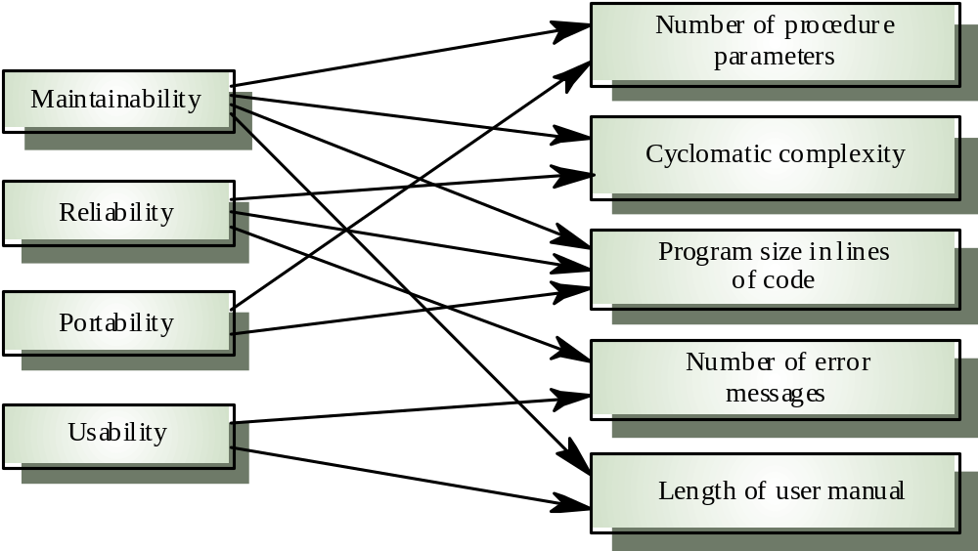
Internal and External Attributes

Slide 29
The Measurement Process
A software measurement process may be part of a quality control process
Data collected during this process should be maintained as an organizational resource
Once a measurement database has been established, comparisons across projects become possible

Slide 30
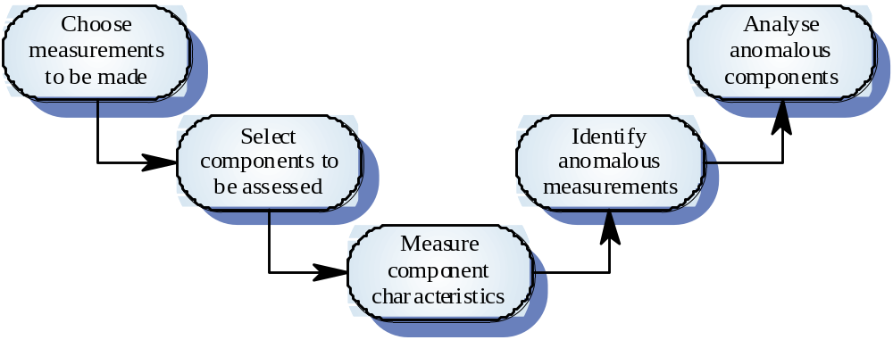
Product Measurement Process

Slide 31
Data Collection
A metrics program should be based on a set of product and process data
Data should be collected immediately (not in retrospect) and, if possible, automatically
Three types of automatic data collection
  Static product analysis
  Dynamic product analysis
  Process data collection

Slide 32
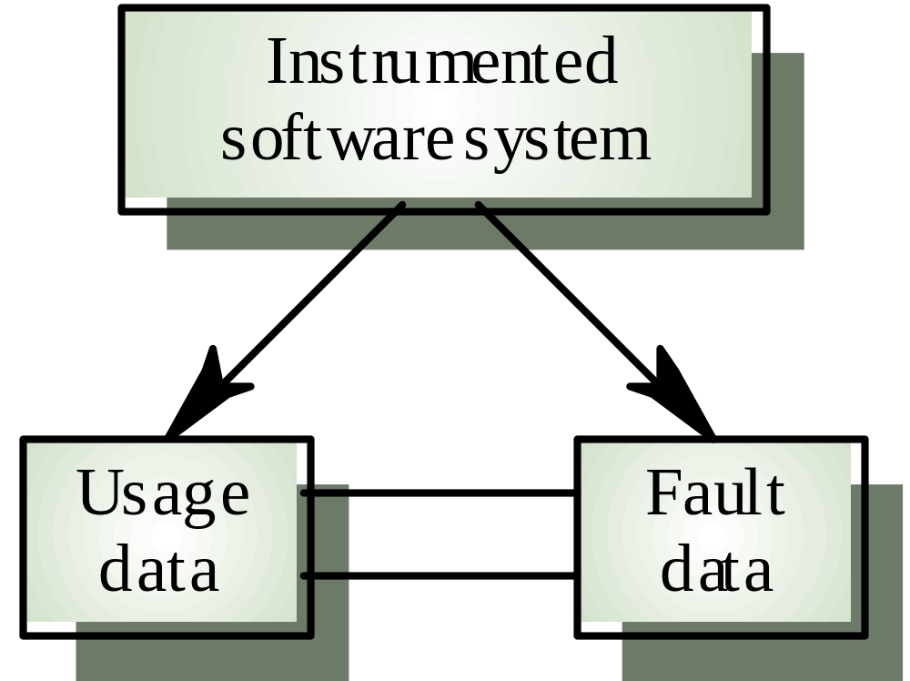
Automated Data Collection

Slide 33
Data Accuracy
Don’t collect unnecessary data
  The questions to be answered should be decided in advance and the required data identified
Tell people why the data is being collected
  It should not be part of personnel evaluation
Don’t rely on memory
  Collect data when it is generated not after a project has finished

Slide 34
Product Metrics
A quality metric should be a predictor of
product quality
Classes of product metric
  Dynamic metrics which are collected by measurements made of a program in execution
  Static metrics which are collected by measurements made of the system representations
  Dynamic metrics help assess efficiency and reliability; static metrics help assess complexity, understand ability and maintainability

Slide 35
Dynamic and Static Metrics
Dynamic metrics are closely related to software quality attributes
  It is relatively easy to measure the response time of a system (performance attribute) or the number of failures (reliability attribute)
Static metrics have an indirect relationship with quality attributes
  You need to try and derive a relationship between these metrics and properties such as complexity, understand ability and maintainability

Slide 36
Measurement Analysis
It is not always obvious what data means
  Analyzing collected data is very difficult
Professional statisticians should be consulted if available
Data analysis must take local circumstances into account

Slide 37
Measurement Surprises
Reducing the number of faults in a program leads to an increased number of help desk calls
  The program is now thought of as more reliable and so has a wider more diverse market. The percentage of users who call the help desk may have decreased but the total may increase
  A more reliable system is used in a different way from a system where users work around the faults. This leads to more help desk calls

Slide 38
Key Points
Software measurement gathers information about both the software process and the software product
Product quality metrics should be used to identify potentially problematical components
There are no standardized and universally applicable software metrics

Slide 39
Project Work
Next Topic: Quality Assurance
Continue working on your Design Specification
Continue working on your prototype

